Slide 1
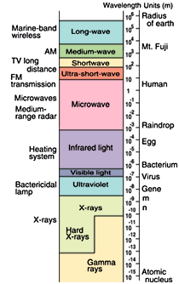
Lecture 26. Blackbody Radiation (Ch. 7)
Two types of bosons:
Composite particles which contain an even number of fermions. These number of these particles is conserved if the energy does not exceed the dissociation energy (~ MeV in the case of the nucleus).
(b) particles associated with a field, of which the most important example is the photon. These particles are not conserved: if the total energy of the field changes, particles appear and disappear. We’ll see that the chemical potential of such particles is zero in equilibrium, regardless of density.

Slide 2
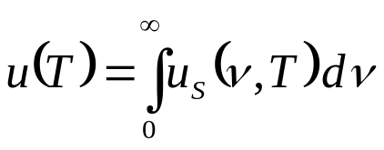
Radiation in Equilibrium with Matter
Typically, radiation emitted by a hot body, or from a laser is not in equilibrium: energy is flowing outwards and must be replenished from some source. The first step towards understanding of radiation being in equilibrium with matter was made by Kirchhoff, who considered a cavity filled with radiation, the walls can be regarded as a heat bath for radiation.
The walls emit and absorb e.-m. waves. In equilibrium, the walls and radiation must have the same temperature T. The energy of radiation is spread over a range of frequencies, and we define u_{S} (ν,T) dν as the energy density (per unit volume) of the radiation with frequencies between ν and ν+dν. u_{S}(ν,T) is the spectral energy density. The internal energy of the photon gas:
In equilibrium, u_{S} (ν,T) is the same everywhere in the cavity, and is a function of frequency and temperature only. If the cavity volume increases at T=const, the internal energy U = u (T) V also increases. The essential difference between the photon gas and the ideal gas of molecules: for an ideal gas, an isothermal expansion would conserve the gas energy, whereas for the photon gas, it is the energy density which is unchanged, the number of photons is not conserved, but proportional to volume in an isothermal change.
A real surface absorbs only a fraction of the radiation falling on it. The absorptivity α is a function of ν and T; a surface for which α(ν ) =1 for all frequencies is called a black body.

Slide 3



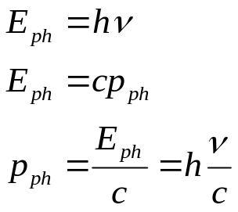
Photons
The electromagnetic field has an infinite number of modes (standing waves) in the cavity. The black-body radiation field is a superposition of plane waves of different frequencies. The characteristic feature of the radiation is that a mode may be excited only in units of the quantum of energy hν (similar to a harmonic oscillators) :
T
This fact leads to the concept of photons as quanta of the electromagnetic field. The state of the el.-mag. field is specified by the number n for each of the modes, or, in other words, by enumerating the number of photons with each frequency.
According to the quantum theory of radiation, photons are massless bosons of spin 1 (in units ħ). They move with the speed of light :
The linearity of Maxwell equations implies that the photons do not interact with each other. (Non-linear optical phenomena are observed when a large-intensity radiation interacts with matter).
The mechanism of establishing equilibrium in a photon gas is absorption and emission of photons by matter. Presence of a small amount of matter is essential for establishing equilibrium in the photon gas. We’ll treat a system of photons as an ideal photon gas, and, in particular, we’ll apply the BE statistics to this system.

Slide 4
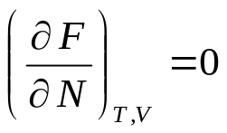
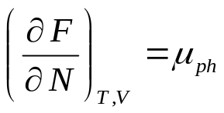

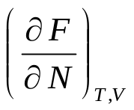

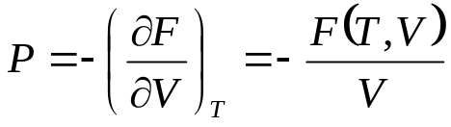

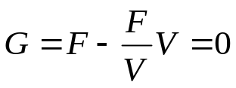
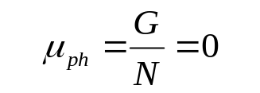
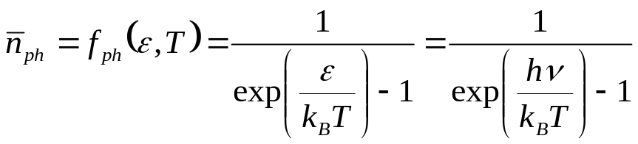
Chemical Potential of Photons = 0
The mechanism of establishing equilibrium in a photon gas is absorption and emission of photons by matter. The textbook suggests that N can be found from the equilibrium condition:
On the other hand,
Thus, in equilibrium, the chemical potential for a photon gas is zero:
However, we cannot use the usual expression for the chemical potential, because one cannot increase N (i.e., add photons to the system) at constant volume and at the same time keep the temperature constant:
- does not exist for the photon gas
Instead, we can use
- by increasing the volume at T=const, we proportionally scale F
Thus,
- the Gibbs free energy of an equilibrium photon gas is 0 !
For μ = 0, the BE distribution reduces to the Planck’s distribution:
Planck’s distribution provides the average number of photons in a single mode of frequency ν = ε/h.

Slide 5
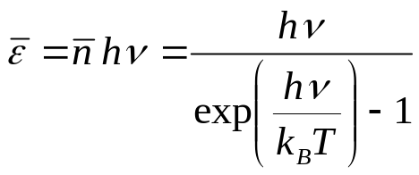

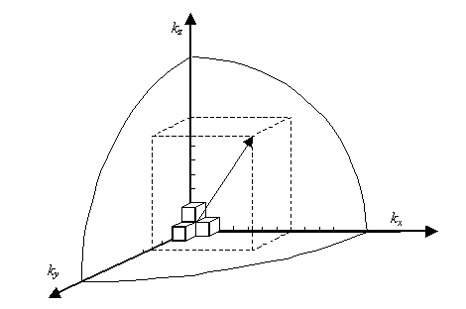
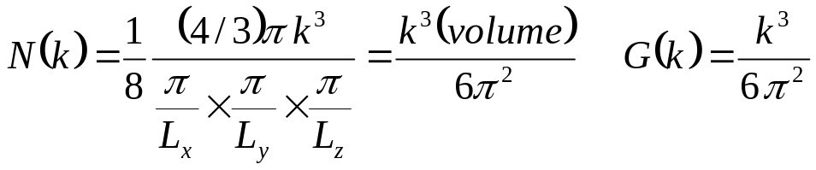
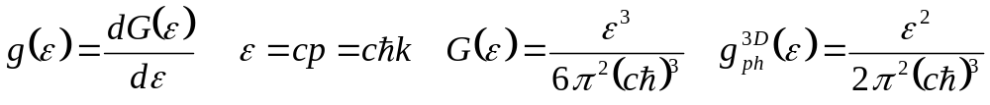
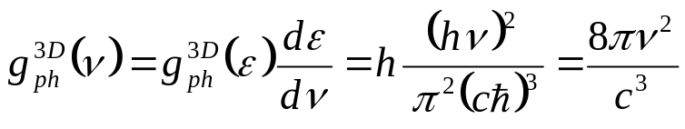
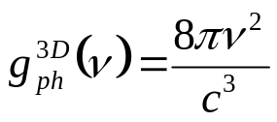
Density of States for Photons
The average energy in the mode:
In the classical (hν << k_{B}T) limit:
In order to calculate the average number of photons per small energy interval dε, the average energy of photons per small energy interval dε, etc., as well as the total average number of photons in a photon gas and its total energy, we need to know the density of states for photons as a function of photon energy.
k_{z}
k_{x}
k_{y}
extra factor of 2 due to two polarizations:

Slide 6


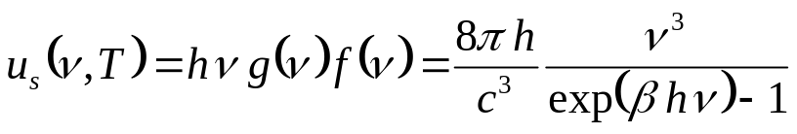
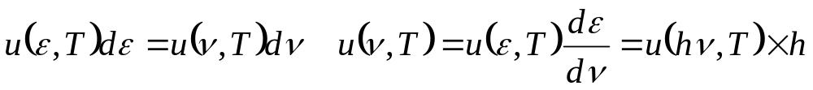
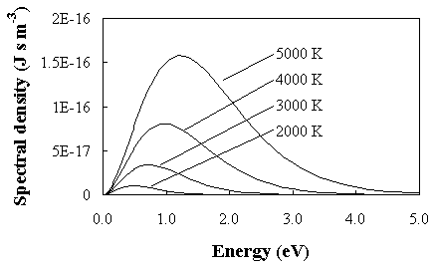
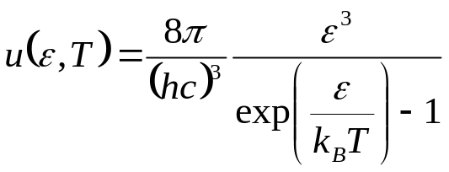
Spectrum of Blackbody Radiation
The average energy of photons with frequency between ν and ν+dν (per unit volume):
photon energy
average number of photons
n(ν )
×
=
hν g(ν )
hν g(ν ) n(ν )
ν
ν
ν
- the spectral density of the black-body radiation
(the Plank’s radiation law)
u as a function of the energy:
u(ε,T) - the energy density per unit photon energy for a photon gas in equilibrium with a blackbody at temperature T.

Slide 7
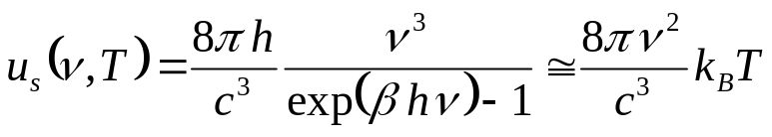
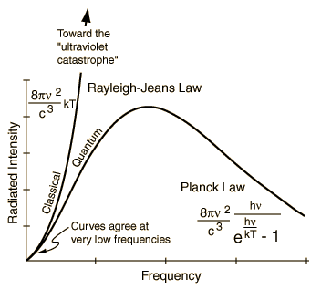
Classical Limit (small f, large λ), Rayleigh-Jeans Law
At low frequencies or high temperatures:
- purely classical result (no h), can be obtained directly from equipartition
Rayleigh-Jeans Law
This equation predicts the so-called ultraviolet catastrophe – an infinite amount of energy being radiated at high frequencies or short wavelengths.

Slide 8
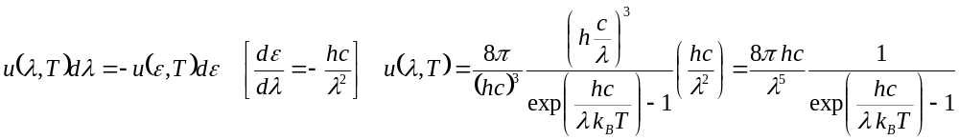
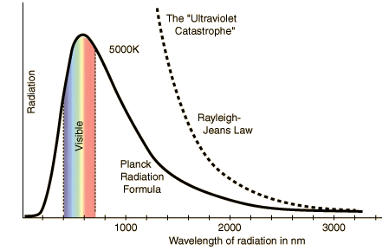
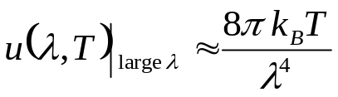

Rayleigh-Jeans Law (cont.)
u as a function of the wavelength:
In the classical limit of large λ:

Slide 9
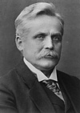
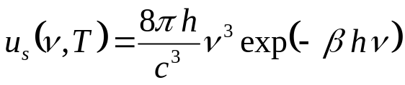
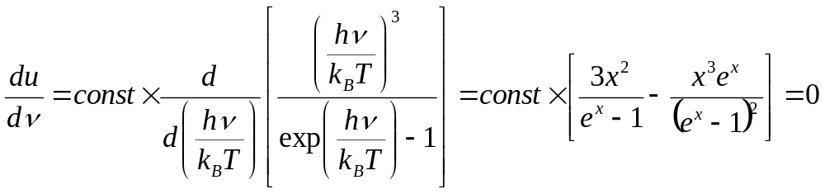
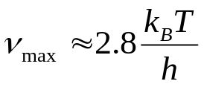

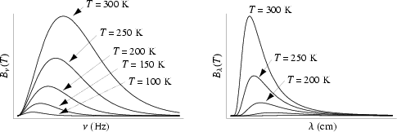
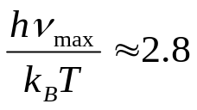
High ν limit, Wien’s Displacement Law
At high frequencies/low temperatures:
Nobel 1911
The maximum of u(ν) shifts toward higher frequencies with increasing temperature. The position of maximum:
Wien’s displacement law
- discovered experimentally by Wilhelm Wien
u(ν,T)
- the “most likely” frequency of a photon in a blackbody radiation with temperature T
Numerous applications
(e.g., non-contact radiation thermometry)
ν

Slide 10


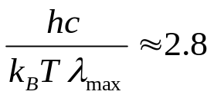


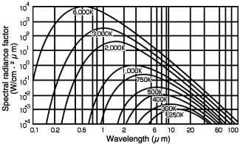

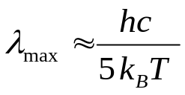
ν_{max} ⇔ λ_{max}
- does this mean that
?
No!
→
T = 300 K
→
λ_{max} ≈ 10 μm
“night vision” devices

Slide 11
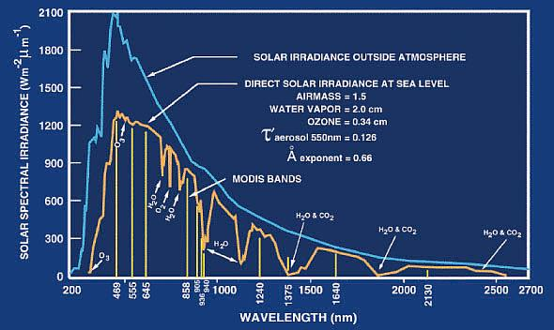
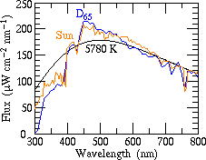
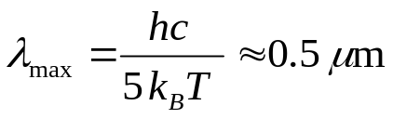

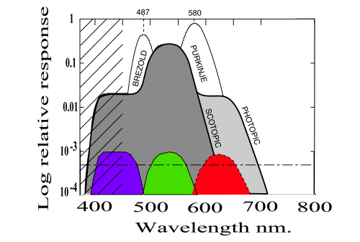
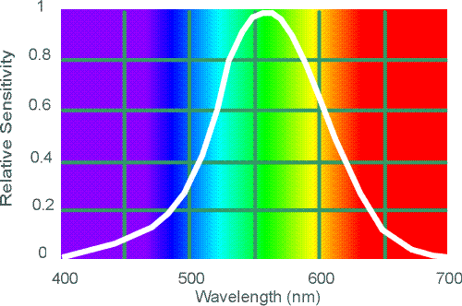
Solar Radiation
The surface temperature of the Sun - 5,800K.
As a function of energy, the spectrum of sunlight peaks at a photon energy of
- close to the energy gap in Si, ~1.1 eV, which has been so far the best material for solar cells
Spectral sensitivity of human eye:

Slide 12
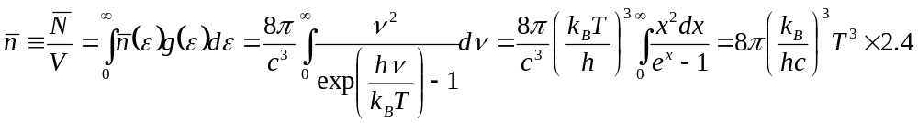
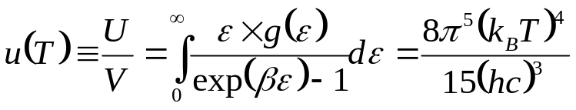
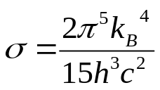
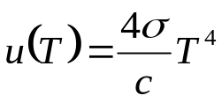
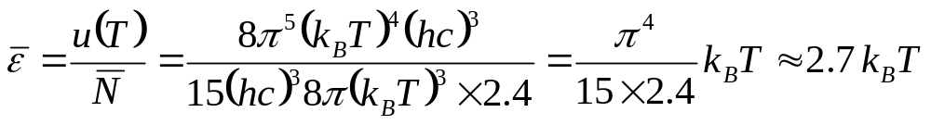


Stefan-Boltzmann Law of Radiation
The total number of photons per unit volume:
- increases as T ³
The total energy of photons per unit volume : (the energy density of a photon gas)
the Stefan-Boltzmann
constant
the Stefan-Boltzmann Law
The average energy per photon:
(just slightly less than the “most” probable energy)
Some numbers:
The value of the Stefan-Boltzmann constant:
Consider a black body at 310K. The power emitted by the body:
While the emissivity of skin is considerably less than 1, it still emits a considerable power in the infrared range. For example, this radiation is easily detectable by modern techniques (night vision).

Slide 13

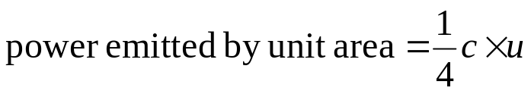
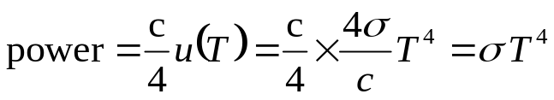

Power Emitted by a Black Body
For the “uni-directional” motion, the flux of energy per unit area
T
energy density u
1m²
c × 1s
Integration over all angles provides a factor of ¼:
(the hole size must be >> the wavelength)
Thus, the power emitted by a unit-area surface at temperature T in all directions:
The total power emitted by a black-body sphere of radius R:

Slide 14
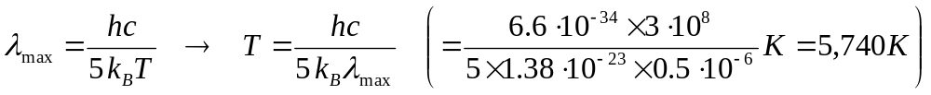
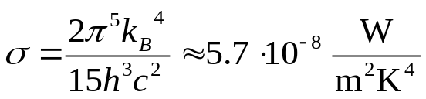
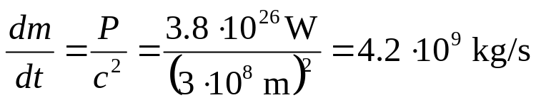
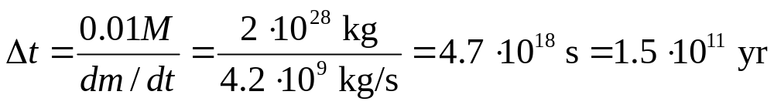
Sun’s Mass Loss
The spectrum of the Sun radiation is close to the black body spectrum with the maximum at a wavelength λ = 0.5 μm. Find the mass loss for the Sun in one second. How long it takes for the Sun to loose 1% of its mass due to radiation? Radius of the Sun: 7·10⁸ m, mass - 2 ·10³⁰ kg.
λ_{max} = 0.5 μm →
This result is consistent with the flux of the solar radiation energy received by the Earth (1370 W/m²) being multiplied by the area of a sphere with radius 1.5·10¹¹ m (Sun-Earth distance).
the mass loss per one second
1% of Sun’s mass will be lost in

Slide 15



Radiative Energy Transfer
Dewar
Liquid nitrogen and helium are stored in a vacuum or Dewar flask, a container surrounded by a thin evacuated jacket. While the thermal conductivity of gas at very low pressure is small, energy can still be transferred by radiation. Both surfaces, cold and warm, radiate at a rate:
i=a for the outer (hot) wall, i=b for the inner (cold) wall,
r – the coefficient of reflection, (1-r) – the coefficient of emission
Let the total ingoing flux be J, and the total outgoing flux be J’:
The net ingoing flux:
If r=0.98 (walls are covered with silver mirror), the net flux is reduced to 1% of the value it would have if the surfaces were black bodies (r=0).

Slide 16





Superinsulation
Two parallel black planes are at the temperatures T₁ and T₂ respectively. The energy flux between these planes in vacuum is due to the blackbody radiation. A third black plane is inserted between the other two and is allowed to come to an equilibrium temperature T₃. Find T₃ , and show that the energy flux between planes 1 and 2 is cut in half because of the presence of the third plane.
T₁
T₃
T₂
Without the third plane, the energy flux per unit area is:
The equilibrium temperature of the third plane can be found from the energy balance:
The energy flux between the 1st and 2nd planes in the presence of the third plane:
- cut in half
Superinsulation: many layers of aluminized Mylar foil loosely wrapped around the helium bath (in a vacuum space between the walls of a LHe cryostat). The energy flux reduction for N heat shields:

Slide 17






The Greenhouse Effect
Absorption:
the flux of the solar radiation energy received by the Earth ~ 1370 W/m²
Emission:
R_{orbit} = 1.5·10¹¹ m
R_{Sun} = 7·10⁸ m
Transmittance of the Earth atmosphere
α = 1 – T_{Earth} = 280K
In reality
α = 0.7 – T_{Earth} = 256K
To maintain a comfortable temperature on the Earth, we need the Greenhouse Effect !
However, too much of the greenhouse effect leads to global warming:

Slide 18






Thermodynamic Functions of Blackbody Radiation
The heat capacity of a photon gas at constant volume:
This equation holds for all T (it agrees with the Nernst theorem), and we can integrate it to get the entropy of a photon gas:
Now we can derive all thermodynamic functions of blackbody radiation:
the Helmholtz free energy:
the Gibbs free energy:
the pressure of a photon gas
(radiation pressure)
For comparison, for a non-relativistic monatomic gas – PV = (2/3)U. The difference – because the energy-momentum relationship for photons is ultra-relativistic, and the number of photon depends on T.
In terms of the average density of phonons:

Slide 19


Radiation in the Universe
Approximately 98% of all the photons emitted since the Big Bang are observed now in the submillimeter/THz range.
The dependence of the radiated energy versus wavelength illustrates the main sources of the THz radiation: the interstellar dust, emission from light and heavy molecules, and the 2.7-K cosmic background radiation.
In the spectrum of the Milky Way galaxy, at least one-half of the luminous power is emitted at sub-mm wavelengths

Slide 20




Cosmic Microwave Background
A. Penzias
R. Wilson
Nobel 1978
In the standard Big Bang model, the radiation is decoupled from the matter in the Universe about 300,000 years after the Big Bang, when the temperature dropped to the point where neutral atoms form (T~3000K). At this moment, the Universe became transparent for the “primordial” photons. The further expansion of the Universe can be considered as quasistatic adiabatic (isentropic) for the radiation:
Since V ∝ R³, the isentropic expansion leads to :

Slide 21




CMBR (cont.)
“… for their discovery of the blackbody form and anisotropy of the CMBR”.
Mather, Smoot, Nobel 2006
At present, the temperature of the Planck’s distribution for the CMBR photons is 2.735 K. The radiation is coming from all directions and is quite distinct from the radiation from stars and galaxies.
Alternatively, the later evolution of the radiation temperature may be considered as a result of the red (Doppler) shift (z). Since the CMBR photons were radiated at T~3000K, the red shift z~1000.

Slide 22





Problem 2006 (blackbody radiation)
The cosmic microwave background radiation (CMBR) has a temperature of approximately 2.7 K.
(a) (5) What wavelength λ_{max} (in m) corresponds to the maximum spectral density u(λ,T) of the cosmic background radiation?
(5) What frequency ν_{max} (in Hz) corresponds to the maximum spectral density u(ν,T) of the cosmic background radiation?
(5) Do the maxima u(λ,T) and u(ν,T) correspond to the same photon energy? If not, why?
(a)
(b)
(c)
the maxima u(λ,T) and u(ν,T) do not correspond to the same photon energy. The reason of that is

Slide 23

Problem 2006 (blackbody radiation)
(d) (15) What is approximately the number of CMBR photons hitting the earth per second per square meter [i.e. photons/(s·m²)]?
(d)

